Slide 1
A Data-Driven Approach to Plant Suggestions using Soil Health and Food Price Data
ZEROTH REVIEW
Guided By,
Dr.R.Nallakumar,
Associate Professor,
Department of Artificial Intelligence and Data Science,
Karpagam Institute of Technology,
Coimbatore.
Presented by
S.ARCHANA (721220243003),
S.LINKEDH (721220243028),
M.PRASANTH(721220243045),
K.SRIKANTH(721220243053),
Department of Artificial Intelligence and Data Science,
Karpagam Institute of Technology,
Coimbatore.

Slide 2
Introduction
Agricultural Challenges:
Balancing population growth and environmental concerns, this research addresses farmers' dilemmas in crop selection. Data-driven insights promise sustainable solutions by considering soil health and food market dynamics.
Soil Health Integration:
Unveiling soil's role in crop success, this study employs data from sensors and satellites, alongside historical records. Relationships between soil health and plant performance are quantified for informed planting decisions.
Economic Viability through Data:
Merging soil health and food price data, this approach uncovers correlations between crop yields, soil health, and market prices. Empowering farmers with data-driven choices enhances both ecology and economics.

Slide 3
Problem Identification
Lack of Data-Driven Insights: The current agricultural system relies heavily on traditional knowledge and experience, often resulting in suboptimal crop choices. Without harnessing the power of data analytics, farmers miss out on valuable insights into soil health and market trends, leading to inefficiencies in crop selection and reduced profitability.
Limited Integration of Soil Health Metrics: Soil health indicators significantly impact crop outcomes, yet the existing system often lacks comprehensive integration of these metrics. Farmers might not have access to real-time data on soil composition, fertility, and moisture levels, leading to uninformed decisions and potentially lower yields.
Market-Blind Cultivation: Farmers often lack up-to-date information on food market dynamics, including fluctuating prices and shifting consumer preferences. This disconnect between cultivation and market demand results in situations where crops may be grown in excess or not enough, leading to wastage and financial losses.

Slide 4
Literature Survey
A Data-Driven Approach to Plant Suggestions using Soil Health and Food Price Data
Pradeepta Kumar Sarangi; Deepti Sinha; Sachin Sinha; Neetu Mittal,
"Machine Learning Approach for the Prediction of Consumer Food Price Index",
investigates the use of machine learning techniques for predicting Consumer Food Price Index (CFPI). It evaluates algorithms, explores data preprocessing and feature engineering, discusses challenges, integration of external factors, and suggests future research directions to enhance CFPI prediction accuracy and policy implications.

Slide 5
Literature Survey
A Data-Driven Approach to Plant Suggestions using Soil Health and Food Price Data
Yufei Zhao; Chao Huang; Jiebo Luo
"How to Prepare for the Next Pandemic - Investigation of Correlation Between Food Prices and COVID-19 From Global and Local Perspectives",
This examines pandemic preparedness, focusing on the correlation between food prices and COVID-19. It analyzes global and local perspectives, investigating how pandemic-related disruptions impact food costs. Insights gained contribute to proactive strategies for future pandemic mitigation and food security.

Slide 6
Proposed Work
Regression and Decision Trees Combination:
Combining regression and decision trees leverages regression's ability to capture linear relationships between soil metrics and crop yields, while decision trees handle non-linear patterns in market demand and economic factors. This ensures a more comprehensive understanding of crop performance and desirability.
Holistic Recommendations:
The integrated approach provides holistic recommendations by assessing both agronomic factors (yield prediction from regression) and economic factors (demand prediction from decision trees). This results in well-rounded crop suggestions that align with both soil health and market dynamics.
Interpretability and Practicality:
Decision trees offer transparent decision paths, making it easier for farmers to understand why certain crops are recommended based on market trends. This transparency enhances user trust and aids in making practical, informed planting decisions, promoting sustainable and profitable agriculture.

Slide 7
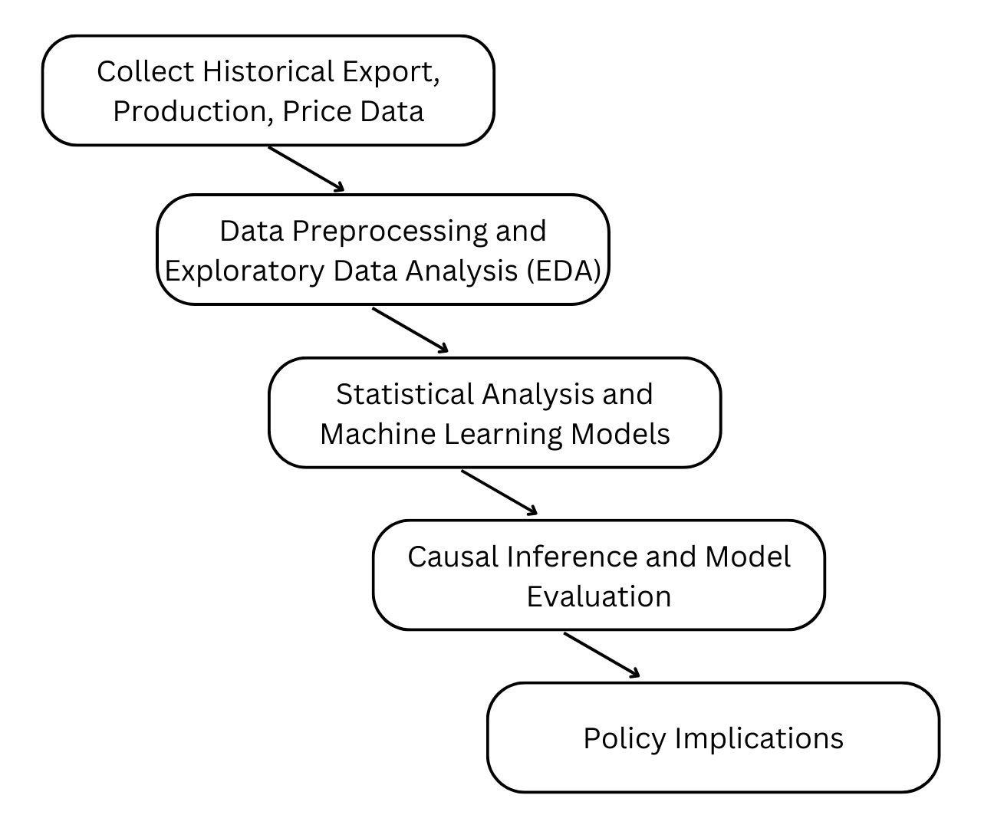
Overall Dataflow Diagram

Slide 8
Algorithm implemented
Regression
It is a statistical method for modeling relationships between a target variable and independent variables. It predicts continuous outcomes, making it valuable for understanding linear associations and making numerical predictions across various fields.
Decision Trees
Decision Trees are graphical models for decision-making. They partition data based on input features, forming branches that lead to final predictions or classifications at leaves. With simplicity, interpretability, and nonlinear adaptability, they suit various tasks and data types.

Slide 9

Expected Deliverables
Real-Time Monitoring and Continuous Improvement
Research and Analysis Documentation
Accurate Predictions
Interactive Recommendation System
Informed Decisions

Slide 10
References
Pradeepta Kumar Sarangi; Deepti Sinha; Sachin Sinha; Neetu Mittal
Machine Learning Approach for the Prediction of Consumer Food Price Index
2021 9th International Conference on Reliability, Infocom Technologies and Optimization (Trends and Future Directions) (ICRITO)
Jenskie Jerlin I. Haban , John Carlo V. Puno
Soil Fertilizer Recommendation System using Fuzzy Logic
2020 IEEE REGION 10 CONFERENCE (TENCON)
Kartika CanFatima A.S Binofai; Maha O. A Mohamad;Mustapha D. Ibrahim
SWOT-4Ps analysis of UAE Organic food market
2022 Advances in Science and Engineering Technology International Conferences (ASET)
Juliana Ngozi Ndunagu; Helen Aderemi; Joseph Bamidele Awotunde
Time Series: Predicting Nigerian Food Prices using ARIMA Model and R-Programming
2022 5th Information Technology for Education and Development (ITED)
Yufei Zhao; Chao Huang; Jiebo Luo
How to Prepare for the Next Pandemic - Investigation of Correlation Between Food Prices and COVID-19 From Global and Local Perspectives
2022 IEEE International Conference on Big Data (Big Data)

Slide 11
Thank You!

